Slide 1
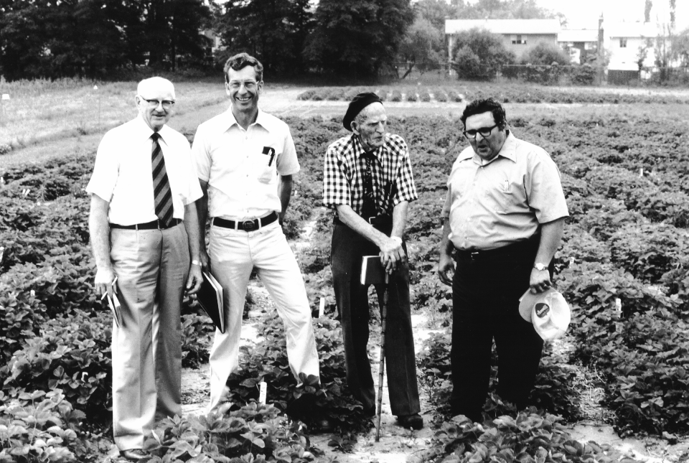
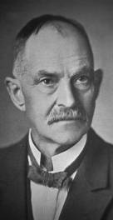
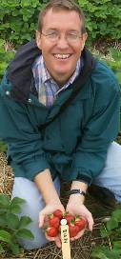
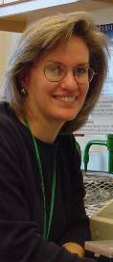
Long history of strawberry breeding…
1946 - 1975
1920 - 1957
1997-2001
1910 - 1922
1965 - 1988
1977 - 1998
2001 -
Notes:
It’s interesting to know that the strawberry breeding and genetics program I inherited is over 100 years old and responsible for starting the strawberry industry and then saving it with its emphasis of breeding for disease resistance.

Slide 2
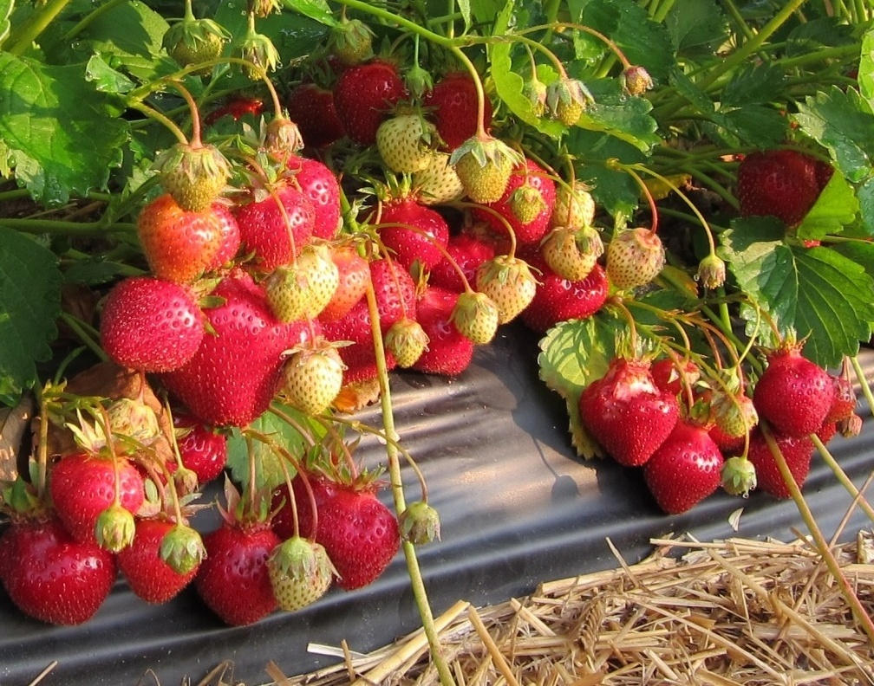
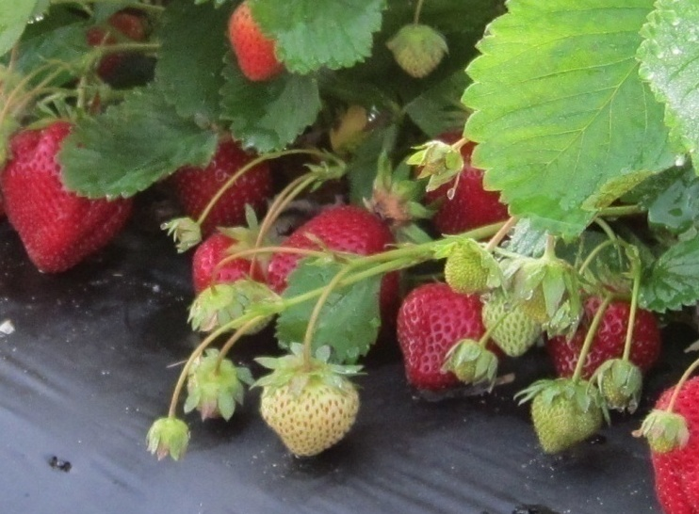
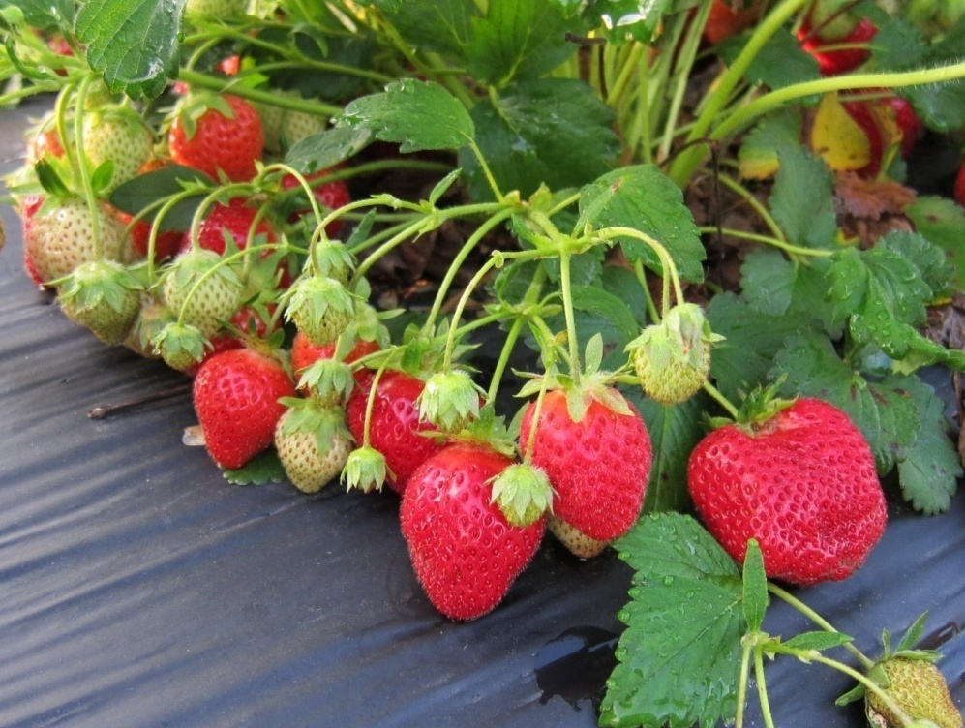
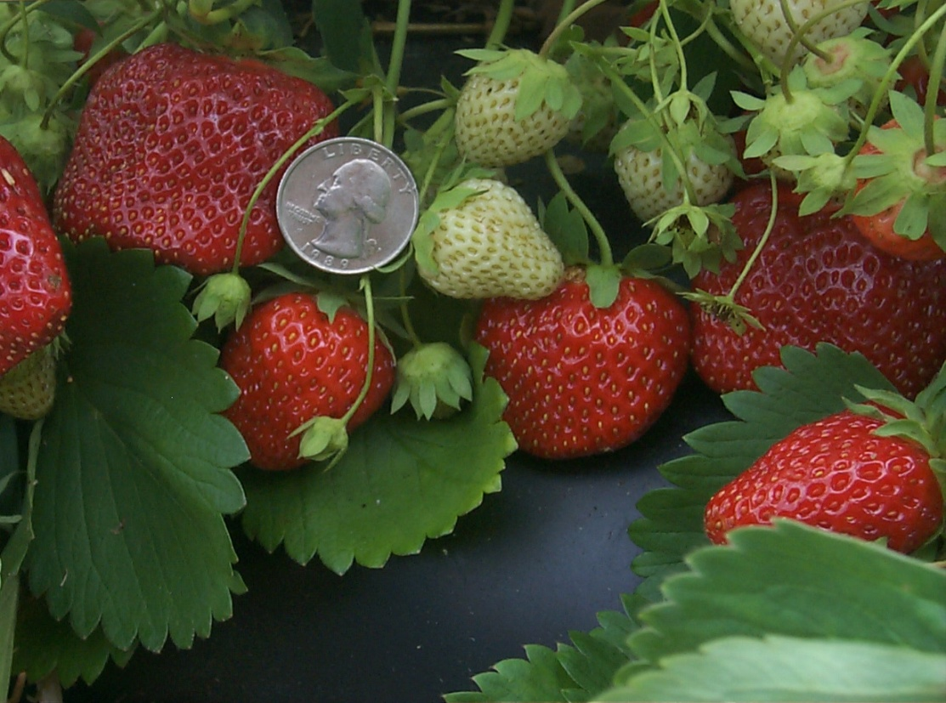
‘Earliglow’
‘Flavorfest’
Disease-resistant USDA-ARS varieties
‘Allstar’
‘Ovation’
Notes:
These are some of the most popular of our strawberry varieties available at nurseries today. They are especially popular because they are disease resistant and great tasting. Their disease resistance makes them popular with organic growers.

Slide 3
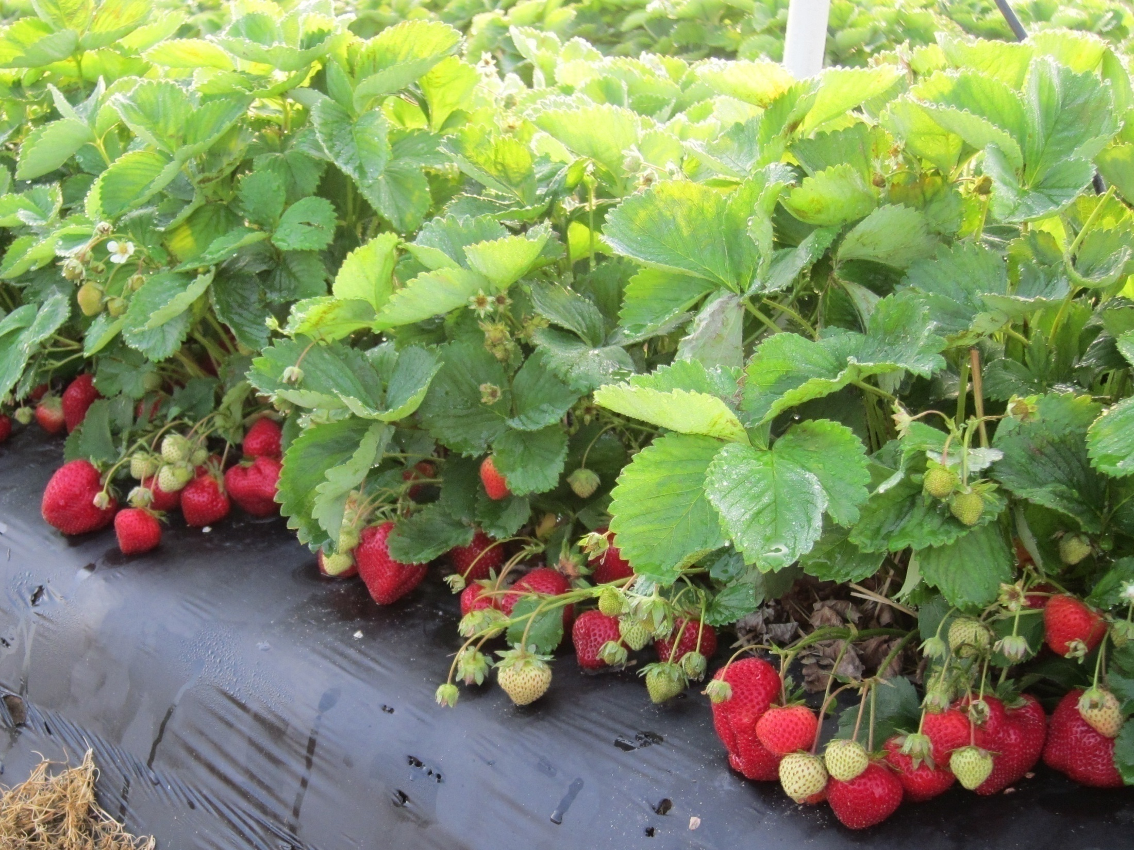
‘Flavorfest’
Notes:
‘Flavorfest’ is our newest.

Slide 4
‘Flavorfest’
Disease resistance
Great flavor
High yield –up to 20 Tons/Acre
Large firm berries – up to 49g
Repeat Fruiting?
Notes:
It has almost everything we want in a strawberry variety…. But it only fruits three weeks a year, during the traditional spring strawberry season, and people want great strawberries all year long.

Slide 5
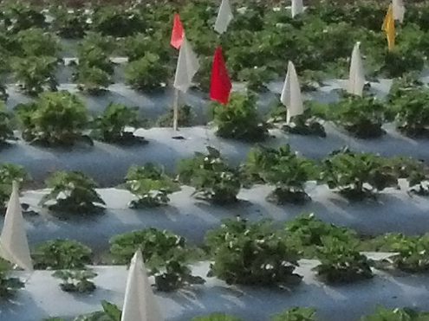
Repeat-fruiting seedling field
Notes:
There are varieties that fruit for longer than three weeks, for most of the year in fact. And I am breeding for this type of strawberry as well as the traditional type. This is so important that we are supporting the repeat-fruiting breeding effort with genetics and production systems too. These white flags identify repeat-fruiting selections in the seedling field, and each breeding family’s segregation ratio is evaluated to estimate the number of loci involved and what their gene action is… dominant, recessive. That’s classical genetics… transmission genetics… Mendelian genetics.

Slide 6
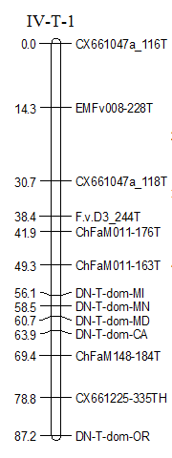
Repeat fruiting in octoploid strawberry mapped as a qualitative trait in five states.
Notes:
And we’re using the more modern approach of mapping this trait with molecular markers. Patricia Castro-Lopez developed a molecular map using data from collaborators in five states. The trait was mapped as a qualitative trait (whether or not a progeny flowered after once-fruiting types stopped flowering)…

Slide 7
Repeat fruiting in octoploid strawberry mapped as a quantitative trait in two states.
a)
b)
c)
LG IV-T-1
LOD
LOD
LOD
Notes:
…and as a quantitatively measured trait (number of weeks a progeny was seen to flower)… to the same location, generally speaking.

Slide 8
SSR markers linked to repeat fruiting in octoploid strawberry in Homoeologous Group IV
Patricia Castro, J.M. Bushakra, P. Stewart, C.K. Weebadde, D. Wang, J.F. Hancock, C.E. Finn, J.J. Luby, K.S. Lewers
 |  | Allele sizes (bp)
Marker |  | ‘Tribute’ |  | ‘Honeoye’ |  | ‘Selva’ |  | ‘Delmarvel’
EMFv008 |  | 198 ^{b}, 202, 204ª, 228 |  | 198 ^{b}, 203, 204 ª |  | 197, 200 ª, 202 ª, 205 ª |  | 200 ª, 202 ª, 220, 228
CX661047a |  | 104, 108 ª, 113 ª, 118 |  | 108 ª, 113 ª |  | 104, 113 ª, 118 |  | 113 ª, 118
F.v.D3 |  | 244, 271ª, 274 ^{b}, 277 ª |  | 271ª, 274 ^{b}, 277 ª, 289 |  | 244ª, 271ª, 277ª |  | 244ª, 271ª, 274, 277ª, 295
ChFaM011 |  | 163, 176 |  | 135 |  | 163 |  | 152, 176
Repeat-fruiting |  | Yes |  | No |  | Yes |  | No
ChFaM148 |  | 175, 177ª, 182^{b}, 184 |  | 177ª, 182^{b} |  | 178, 183, 185, 188 |  | 178, 180, 183, 185, 188
CX661225 |  | 335, 338 ^{b}, 342, 349 ª, 351ª |  | 335, 338 ^{b}, 342, 349 ª, 351 ª |  | 335 ª, 339, 348 ª, 351 ª |  | 339, 343 ª, 345, 348 ª, 351 ª
ª did not fit an expected segregation ratio
^{b} unlinked, not grouped with other markers
Notes:
This gives us a subset of markers to try to use in marker-assisted breeding for repeat fruiting. Patricia currently is mapping the same trait in another population and is finding two completely different linkage groups to be involved. One of my long-term goals is to develop markers like those circled in red that produce only one or two products from any particular genotype, indicating they may be linkage-group specific.

Slide 9
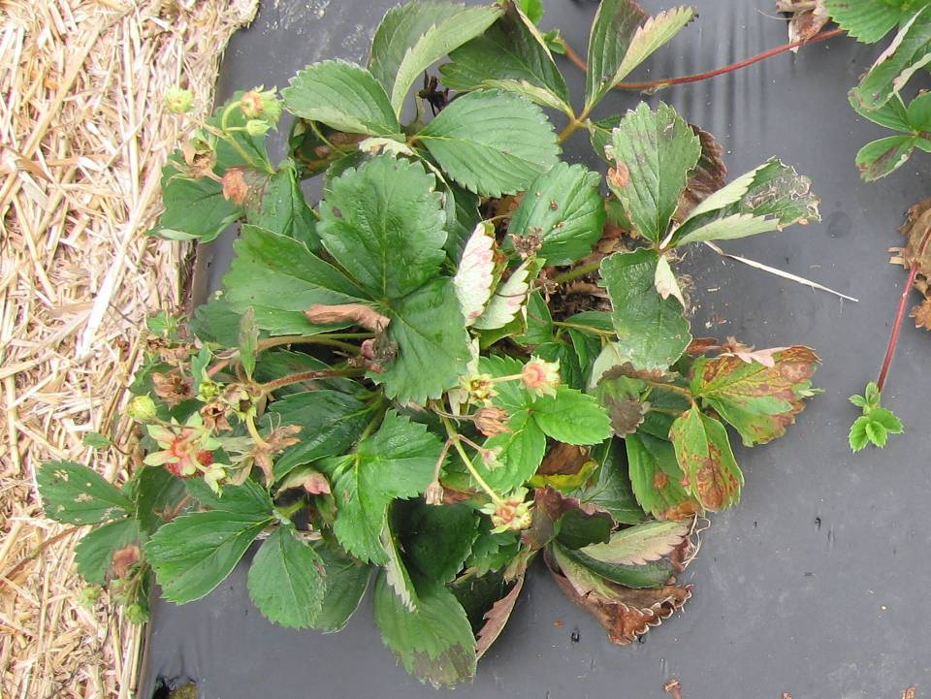
Notes:
But back to the actual breeding… this is what repeat fruiting strawberries look like in the typical Maryland plasticulture production system. I can’t tell a potential variety from a discard with no fruit.

Slide 10
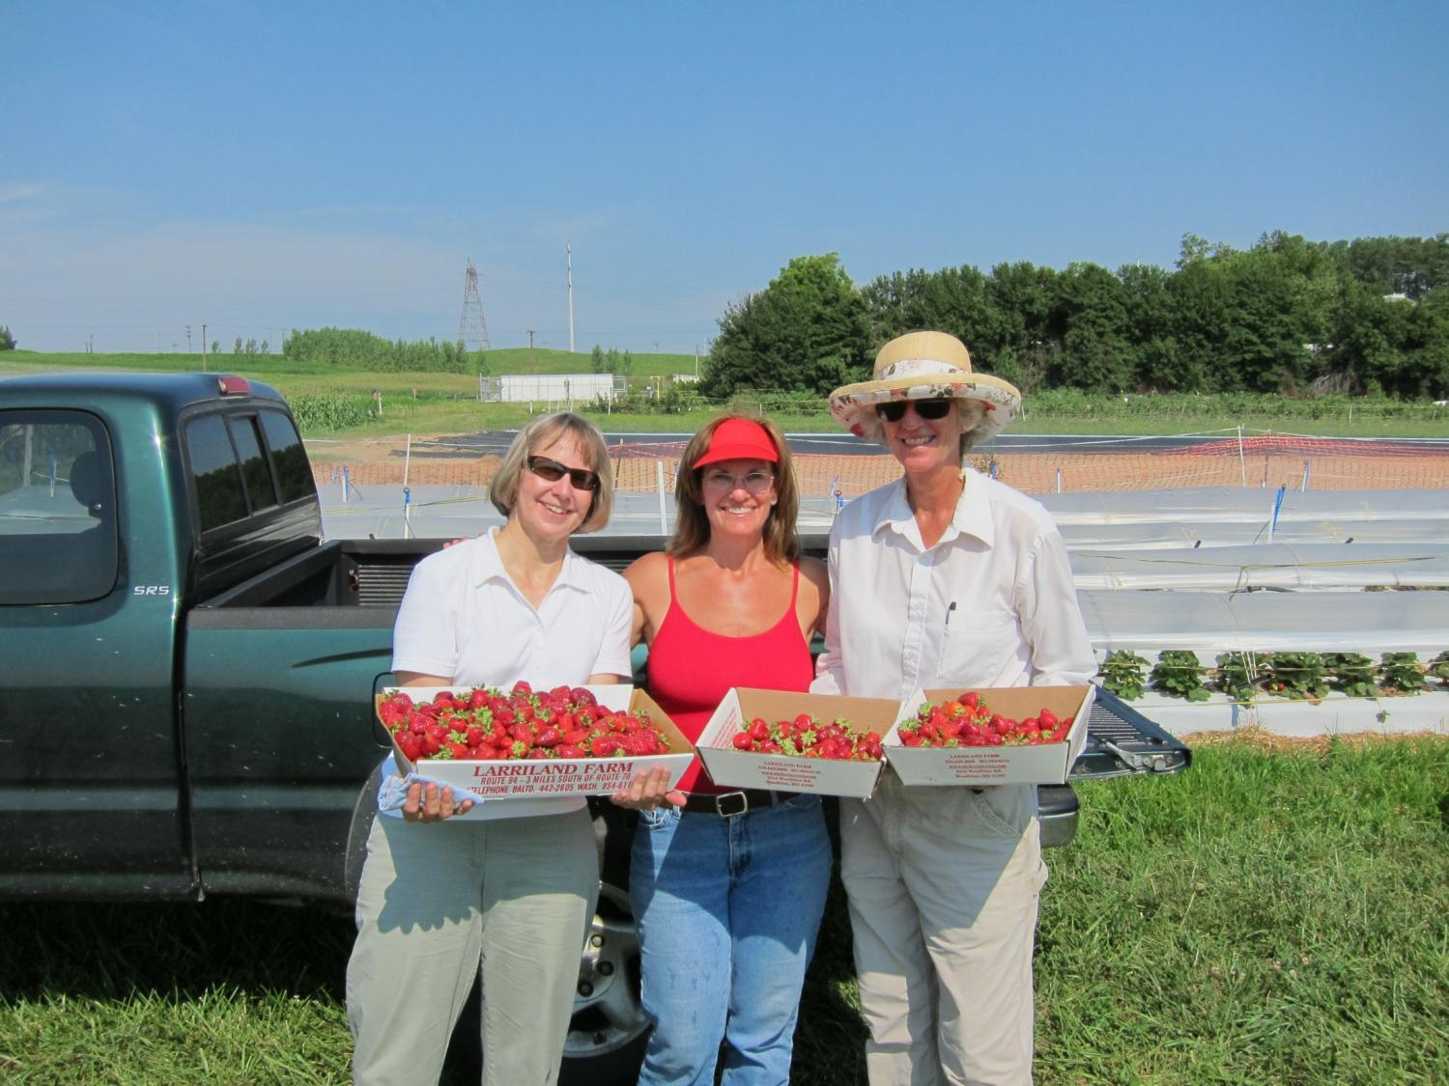
First, let’s talk about yield.
Notes:
So in 2011 we developed a production system that allows us to get big beautiful fruit from the repeat-fruiting genotypes most of the spring, summer and fall.

Slide 11
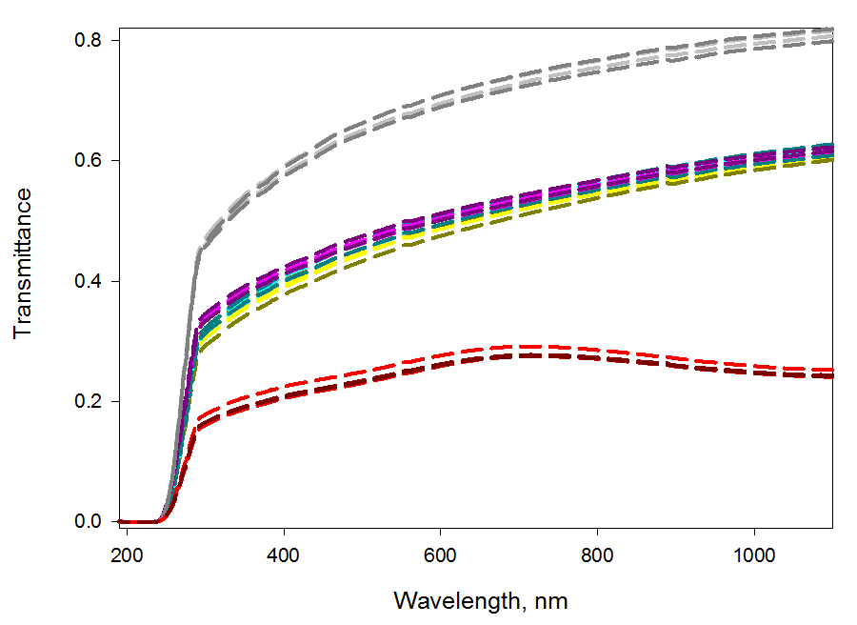
Photosynthetically Active Radiation (PAR)
(400-700nm)
UV (10-400nm)
Infrared (700-1,000 nm)
Standard “clear” plastic
TES plastic (IR diffusing)
TempCool plastic (IR blocking)
Dr. Craig Daughtry, USDA-ARS Beltsville MD
Notes:
It works, we think, because the tunnel plastic filters out stressful IR light and allows the strawberries below to tolerate our hot summers. So we’re experimenting with different plastic types that filter out more levels of IR light.

Slide 12
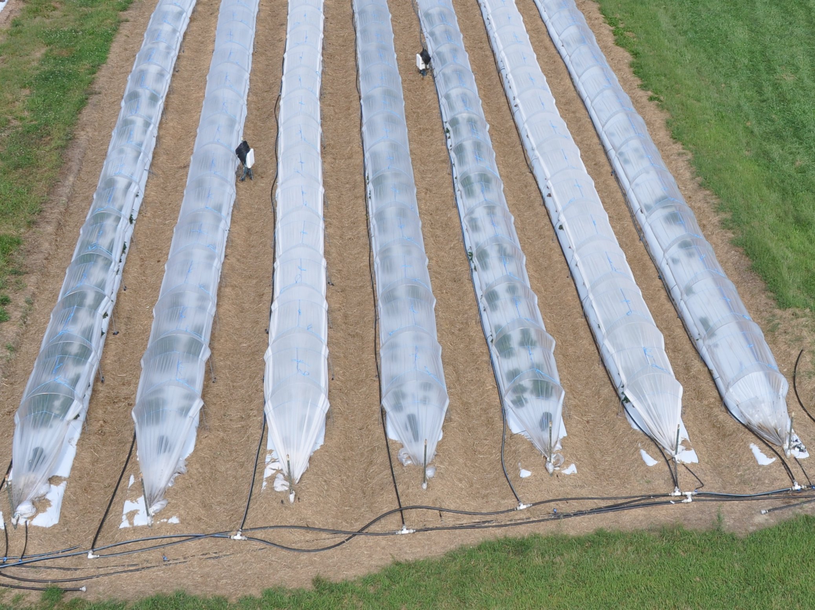
Standard
IR diffusing
IR blocking
IR diffusing
Standard
IR blocking
Notes:
The different light transmission properties are obvious in this photograph.

Slide 13
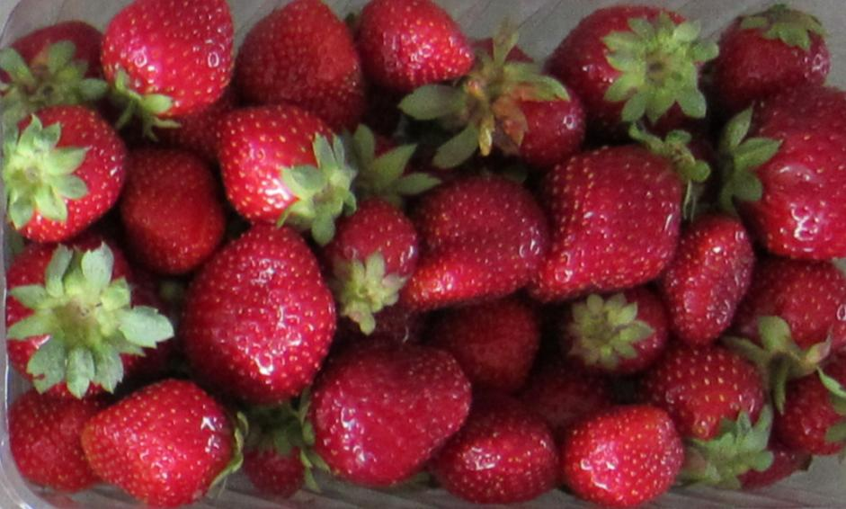
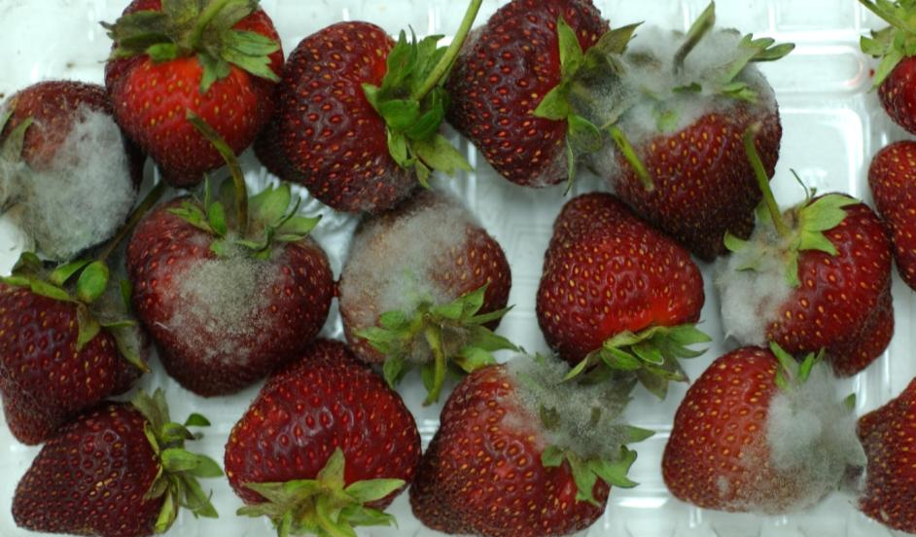
Fruit from tunnels.
And NO FUNGICIDES!
This is Botrytis fruit rot. We did NOT see Botrytis in the tunnel fruit, even after storage.
Notes:
One of the most striking observations, of interest to organic producers especially, was that I didn’t see botrytis fruit rot. There were only four infected berries all of 2011 and six in 2012 in the tunnels. And fruit harvested from the tunnels lasted in the refrigerator with exceptionally good quality and no botrytis. And I didn’t use any fungicides.

Slide 14
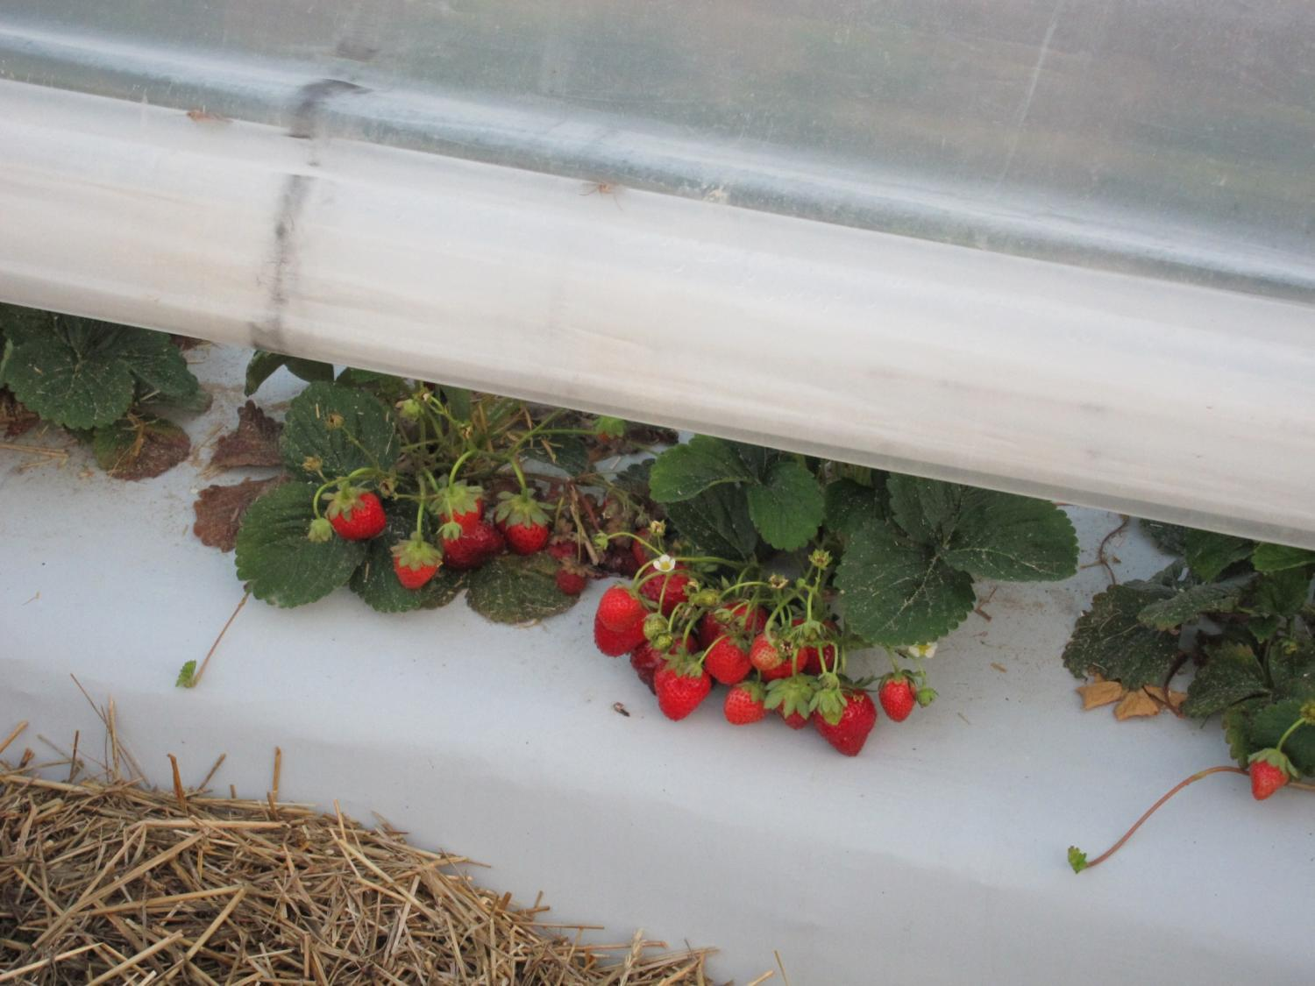
Notes:
I had read that this might be expected because the tunnels act as rain shields to keep the plants dry.

Slide 15
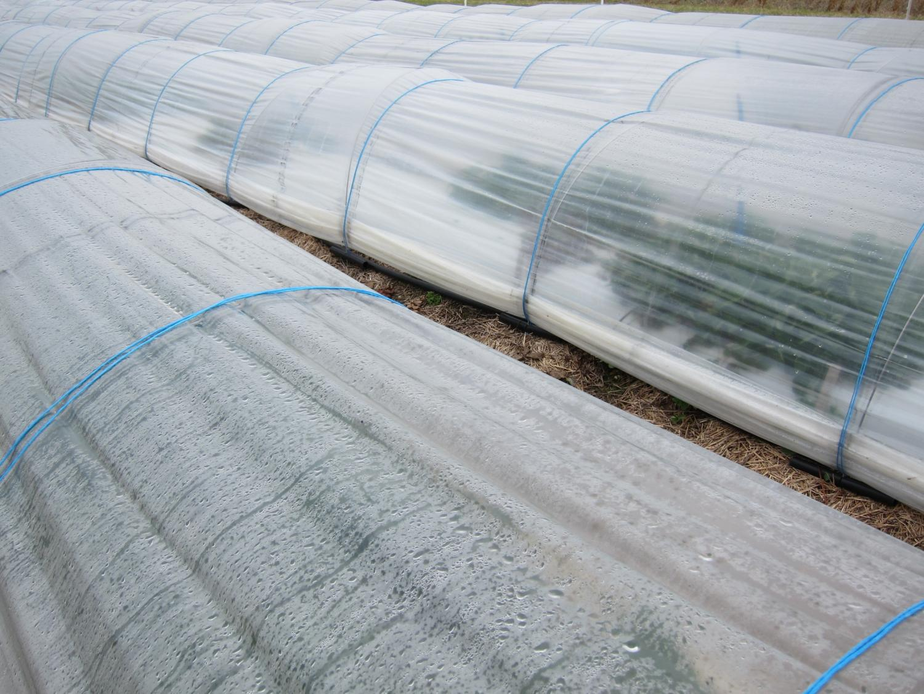
Notes:
But they do get wet in the spring and fall with the frost protection. And temperatures were cool so that Botrytis should have been a problem. But it wasn’t. Why????

Slide 16
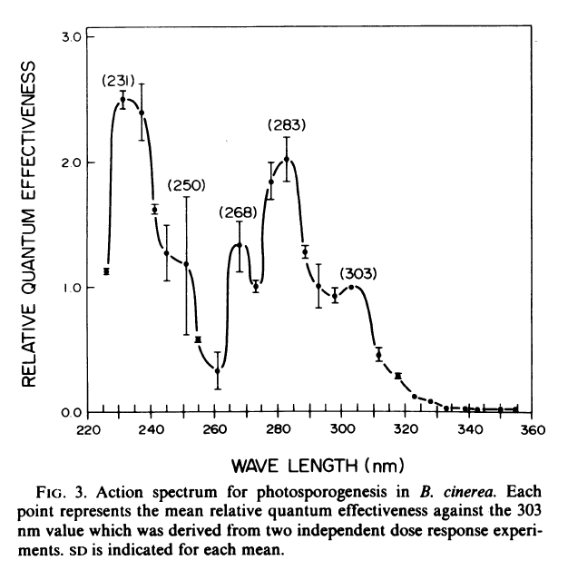
Notes:
It turns out that Botrytis is one of those fungi that needs UV light to make spores so it can spread. And….

Slide 17
Photosynthetically Active Radiation (PAR)
(400-700nm)
UV (10-400nm)
Infrared (700-1,000 nm)
Standard “clear” plastic
TES plastic (IR diffusing)
TempCool plastic (IR blocking)
Dr. Craig Daughtry, USDA-ARS Beltsville MD
Notes:
… it turns out the plastic I used for the tunnels blocks out most of the light wavelengths required for the Botrytis to form spores… so it doesn’t spread. Or at least that’s a good theory. I am hoping that someone does some research on this.
Dr. Craig Daughtry, USDA-ARS, Beltsville, Md. Spectrophotometer.

Slide 18
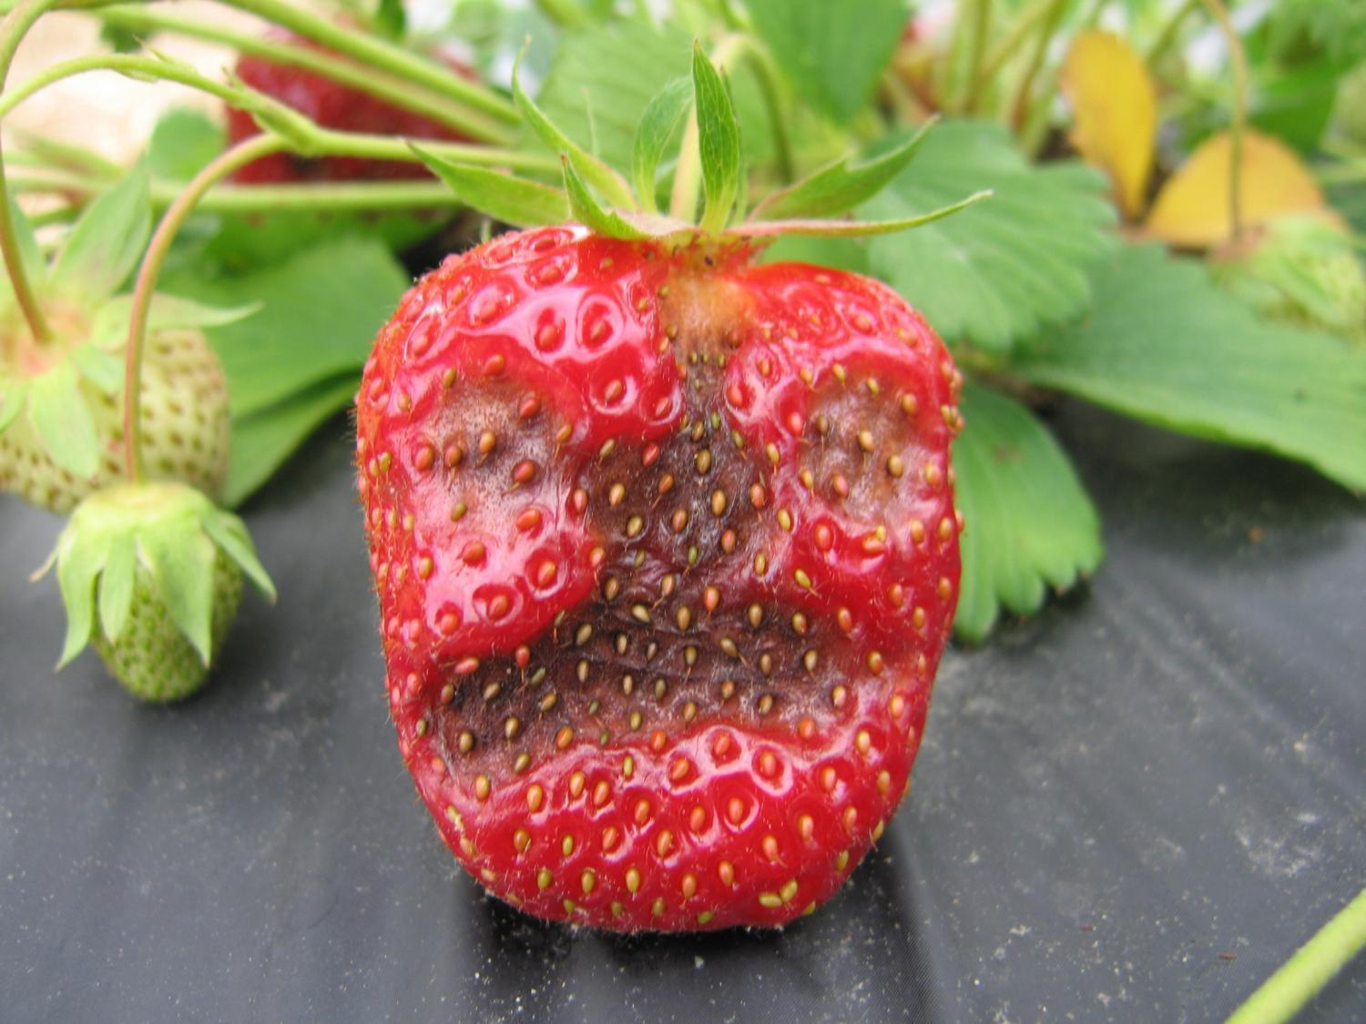
Notes:
And in a heavy rainstorm with high winds and sideways rain, we can get anthracnose for a week on the more susceptible cultivars. But adding a thick coating of straw down the aisle the second and third year practically eliminated anthracnose under the tunnels, though it is still the problem in the open beds with the susceptible varieties from other breeding programs. Because the dayneutral part of the breeding program is new to us, we haven’t had time to breed in the resistance that all our once-fruiting varieties have, though older dayneutrals ‘Tribute’ and ‘Tristar’ are resistant.

Slide 19
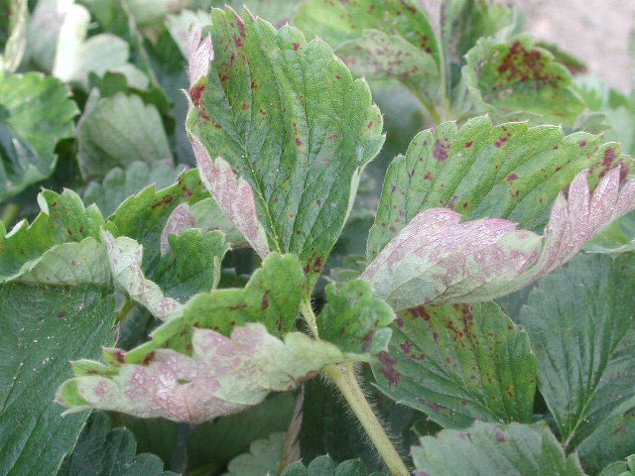
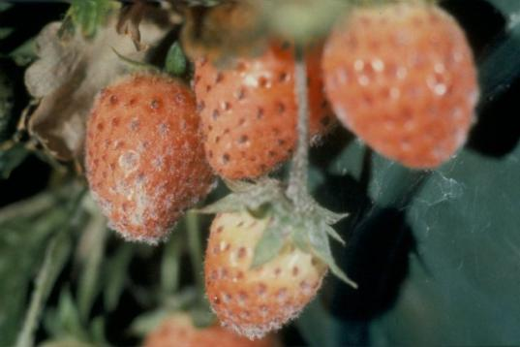
NO powdery mildew!
Notes:
I expected to see a lot of powdery mildew in these tunnels because it’s a problem with high tunnels, but in these low tunnels, there was none.

Slide 20
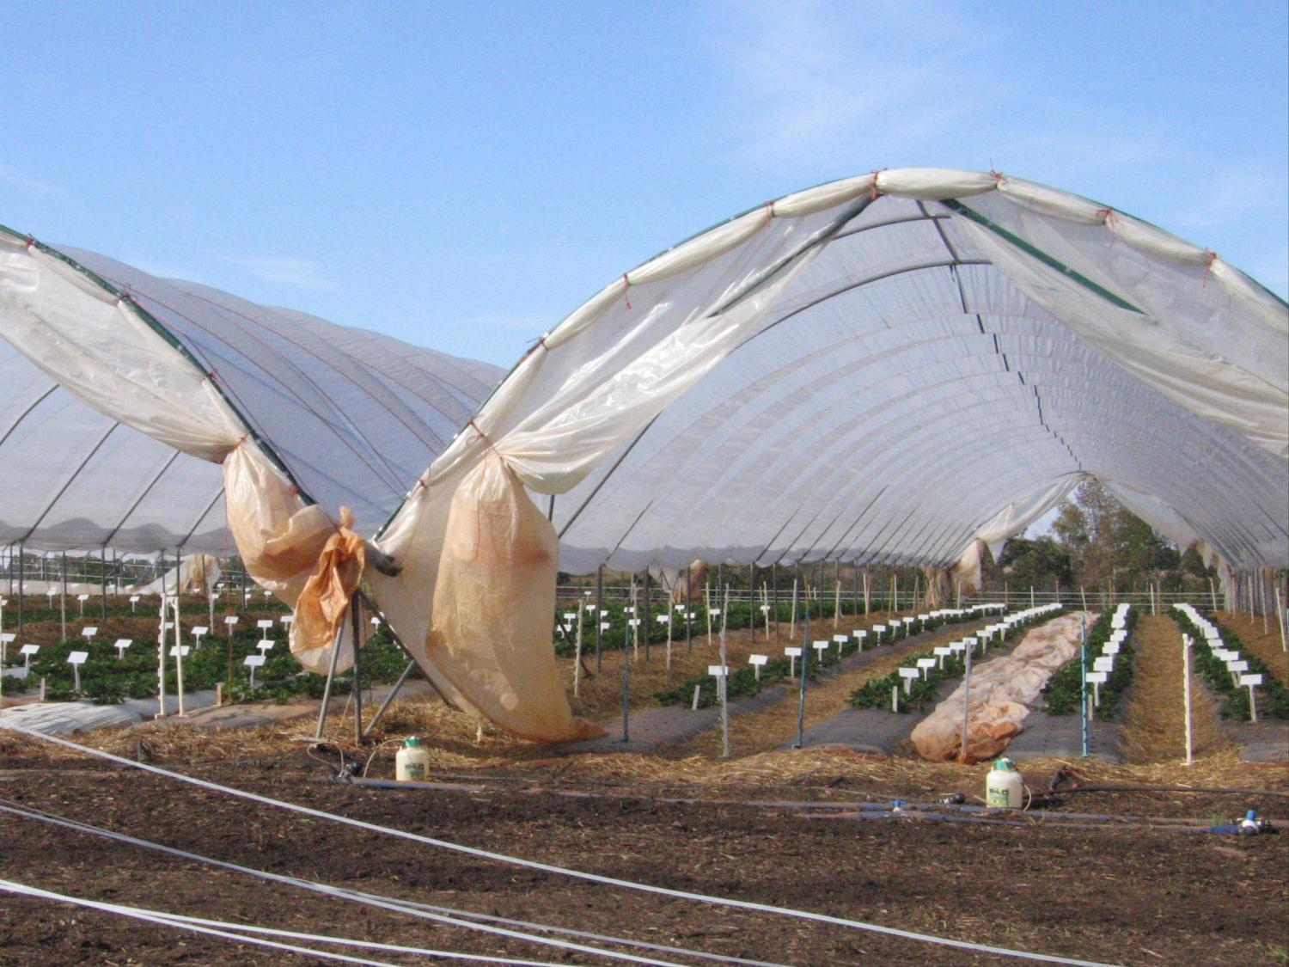
Notes:
Powdery mildew grows really well in high humidity conditions, and high tunnels are often quite humid.

Slide 21
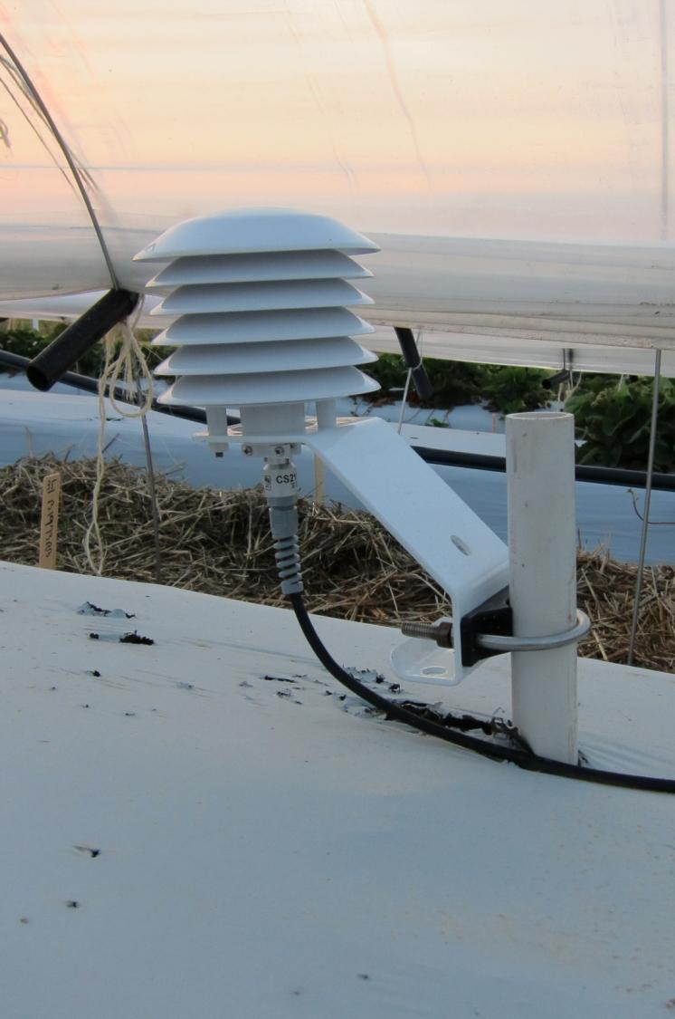
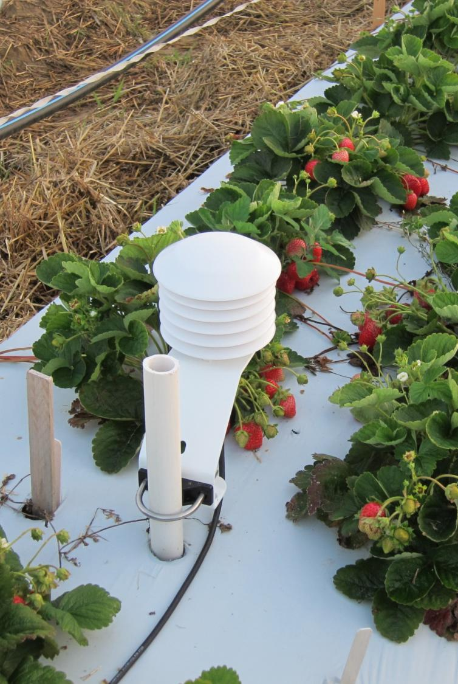
Notes:
But we measured humidity inside and outside the tunnels and they were the same through the summer. After I dropped the sides in early October, the humidity inside the tunnels was actually lower until the first week of November… So maybe that’s why there was no powdery mildew. The low tunnels create a very different micro-environment from high tunnels, because the low tunnels are so much smaller than the high tunnels.

Slide 22
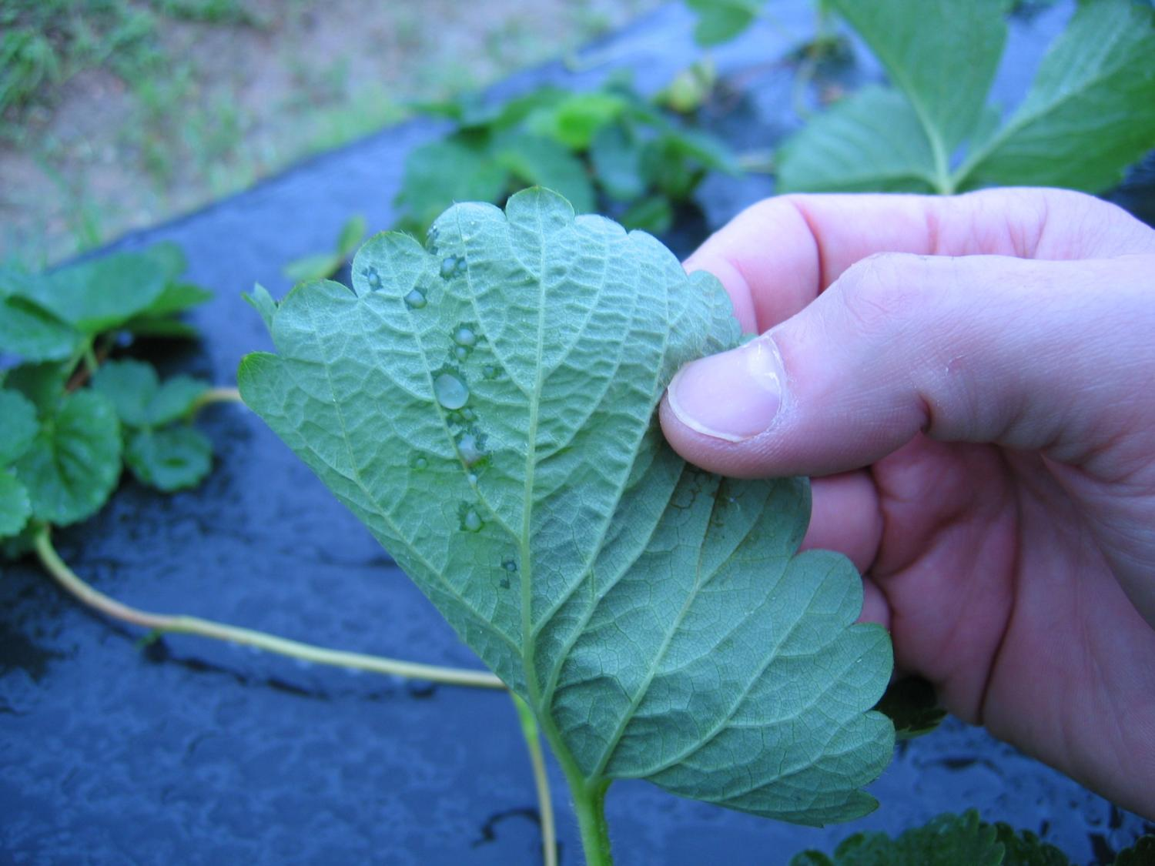
Notes:
Another disease I thought we might see in the cooler temperatures was bacterial angular leafspot disease, but we didn’t. Except for the anthracnose, these low tunnels are pretty disease free.

Slide 23
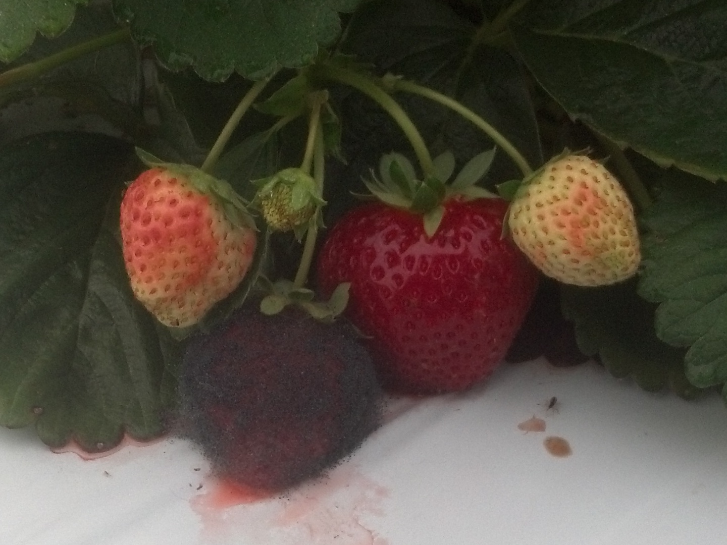
Notes:
Mucor has been our big new problem in the tunnels that we don’t see in the once-fruiting genotypes in spring. And this year we learned it requires warm humid weather in addition to some way to get through the fruit skin.

Slide 24
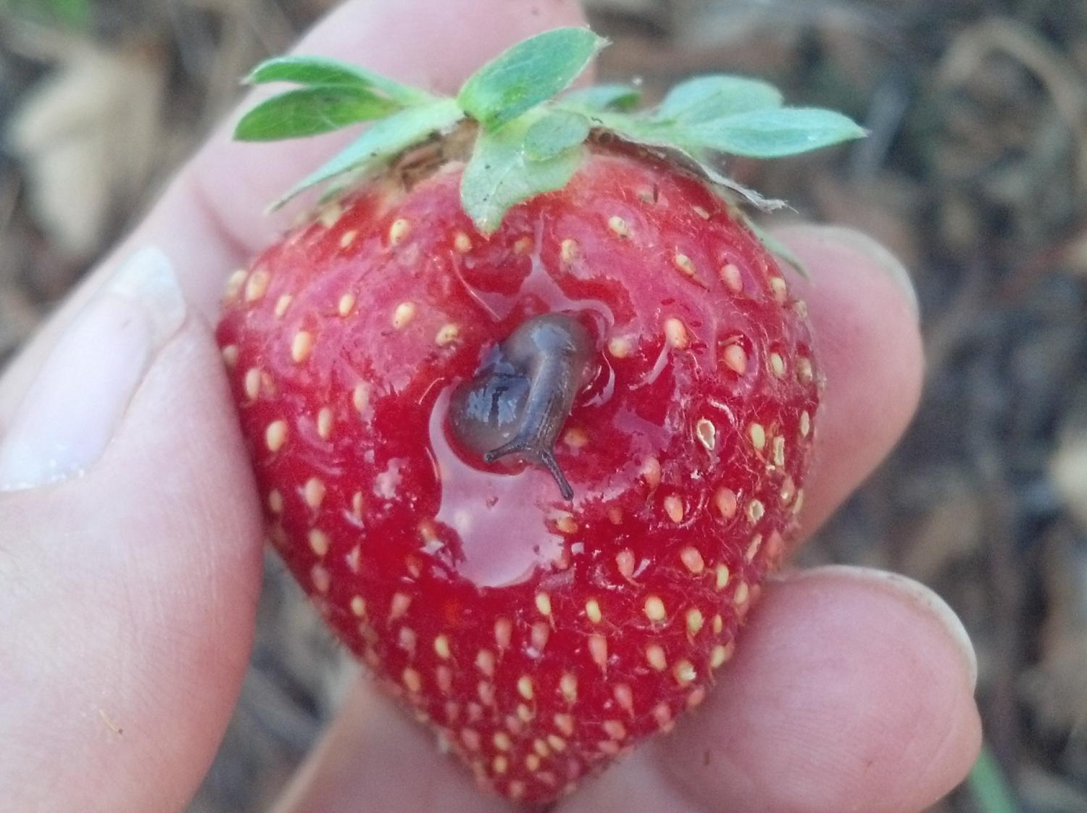
Slugs
Ants
Too much N
Irrigation
Notes:
…like slugs or ants this year. We reduced the problem this year by using less nitrogen fertilizer to make the skin tougher, and by watering only on Mondays and Thursdays when the ripest fruit with the most tender skins have been removed.

Slide 25
Notes:
By fruiting a single set of low-tunnels for two years, we have been able to produce very high quality fruit from mid-April until Christmas in mild years, and with varieties that aren’t even adapted to our location. The extended season reduces risk to growers and provides a steady supply of fruit to consumers. And with breeding we’ve already seen that we can significantly improve yield.

Slide 26
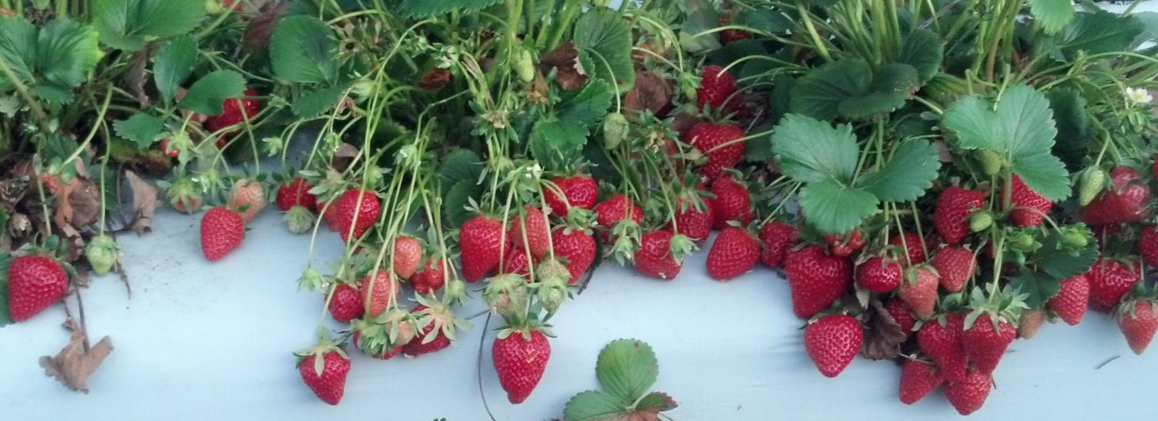
Year-round strawberries
Strawberry breeding
Traditional genetics
Modern molecular genetics
Novel production system
More strawberry breeding… and time
Notes:
So… we are gathering all the tools we need to make locally grown strawberries available all year long… it’s just a matter of time now.

